Slide 1
Data modelling – Part 2 Dr Mariana Rocha School of Computer Science
CMPU 2007 Databases 1, Lecture 2

Slide 2
Difference between Logical and Physical Design
Logical Modelling
Conceptual
Revolves around the needs of the business, not the database, although the needs of the business are used to establish the needs of the database.
Involves gathering information about business processes, business entities (categories of data), and organizational units
It is ok to have many to many relationships

Slide 3
Difference between Logical and Physical Design
Physical
Involves the actual design of a database according to the requirements that were established during logical modelling
Needs to be implementable in the type of database you are working with so we are converting our logical model to a relational data model
Need to resolve the many to many into a series of one to many introducing a weak entity

Slide 4
Our Example
What relationships exist between entities?
A council can have many competitions.
A competitions is run by a single council.
Teams enrol in competitions.
A team can enrol in many competitions.
A competition can have many teams.
What are the relationships at logical level?
How do we resolve the Logical to a Physical Design?

Slide 5
Another example – let’s build the model
A college contains many departments
Each department can offer any number of courses
Many instructors can work in a department
An instructor can work only in one department
For each department, there is a Manager
Each manager can manage only one department
Each instructor can take any number of courses
A course can be taught by only one instructor
A student can enrol for any number of courses
Each course can have any number of students

Slide 6
Identify the entities
What are the entities here?
From the statements given, the entities are
College
Department
Course
Instructor
Student
Manager

Slide 7
Additional Information
Each department has a unique identifier, a name and a location associated with it
Each course has a name and a duration
Instructors and Students and Managers have first names, last names and phone numbers
Each department, course, instructor, manager, and student have a unique id

Slide 8
What are the attributes and datatypes
For the department entity, attributes are id, name, location
For course entity, attributes are id, course_name, duration
For instructor entity, attributes are id, first_name, last_name, phone
For student entity, attributes are id, first_name, last_name, phone

Slide 9
What are the primary keys?
ID can identify a department uniquely. Hence Department_ID is the key attribute for the Entity "Department".
Course_ID is the key attribute for "Course" Entity.
Student_ID is the key attribute for "Student" Entity.
Instructor_ID is the key attribute for "Instructor" Entity.

Slide 10
What are the constraints?
Each department must have a name and a location associated with it
Each course must have a name and a duration
Instructors and Students and Managers must have first names, last names and phone numbers

Slide 11
What are the relationships?
One department offers many courses. But one particular course can be offered by only one department.
Hence the cardinality between department and course is One to Many (1:N)
One department has multiple instructors . But instructor belongs to only one department.
Hence the cardinality between department and instructor is One to Many (1:N)
One department has only one manager and one manager can manage only one department.
Hence the cardinality is one to one. (1:1)

Slide 12
What are the relationships?
One course can enrol many students and one student can enrol for many courses.
Hence the cardinality between course and student is Many to Many (M:N)
One course is taught by only one instructor. But one instructor teaches many courses.
Hence the cardinality between course and instructor is Many to One (N :1)

Slide 13
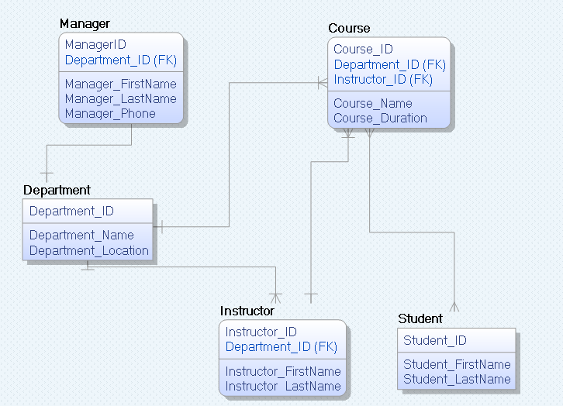
The model
College is not shown but could be

Slide 14
The model
Primary keys are shown above the link
Foreign Keys indicated by (FK) beside the column

Slide 15
Summary
A good data model is simple.
Data attributes that describe any given entity should describe only that entity.
Each attribute of an entity instance can have only one value.
A good data model is essentially non-redundant.
Each data attribute describes at most one entity.
Look for the same attribute recorded more than once under different names.
A good data model should be flexible and adaptable to future needs.

Slide 16
How to create an ERD?
To create an Entity Relationship Diagram, you can use:
Reverse Engineering:
- process of creating an ERD from an existing database system. It's essentially the reverse of the typical database design process.
- used when you have an operational database but lack formal documentation or a clear understanding of its structure.
Forward Engineering:
- process of designing a database from scratch or making significant changes to an existing database system based on a well-defined data model.
- we start with an ERD or a data model that represents the structure of the database you want to create. This model includes entities, attributes, and their relationships.

Slide 17
Using Dbeaver – Reverse engineering
The community (free version) of DBeaver only allows us to work with reverse engineering.
To create the ERD using reverse engineering:
- Run the code for your database creation (DDL)
- Dropdown the menu on the left until you can see the list of tables (if you run the code and still cannot see any table, right-click and click on Refresh)
- Right-click on Tables and click on View Diagram

Slide 18
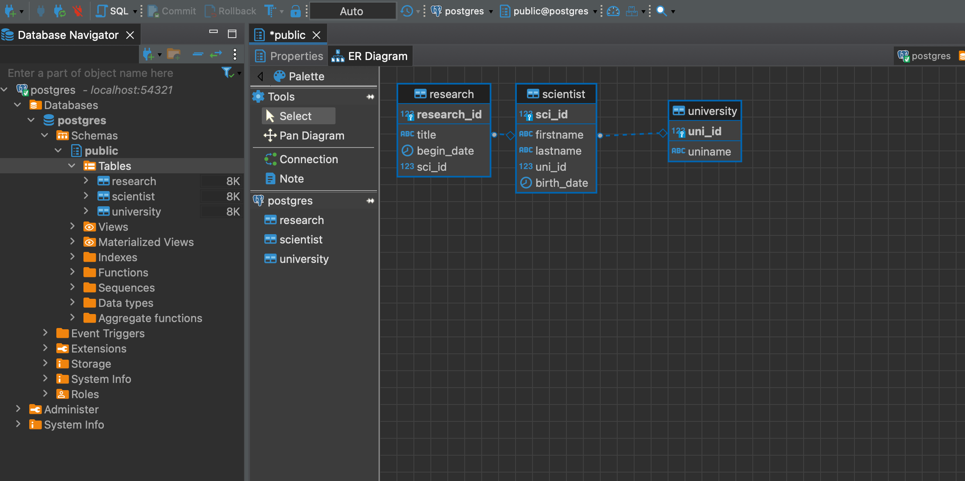

Slide 19
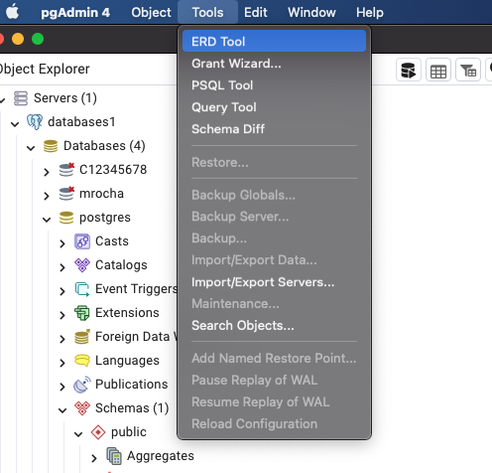
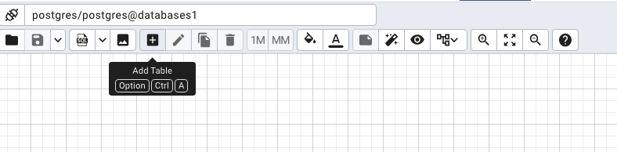
Using pgAdmin 4 – Forward engineering
You can use reverse and forward engineering on pgAdmin 4 (free, open-source). To do that:
- connect to the server (we will be using localhost)
- click on Tools and choose ERD Tool
- Click on the + sign to add a table

Slide 20
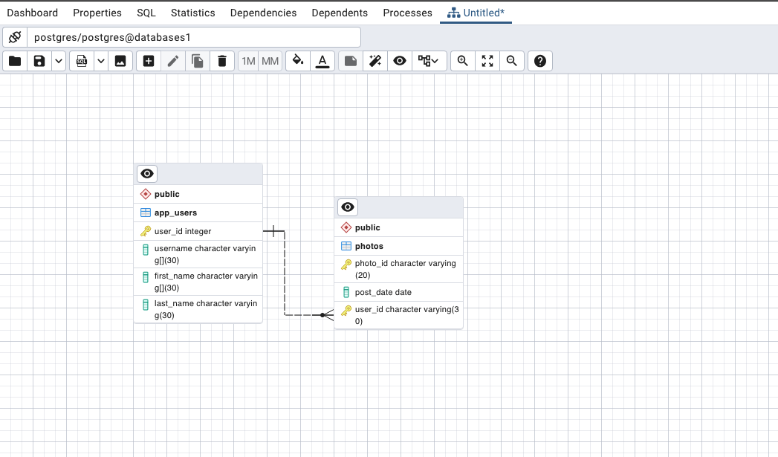

Slide 21


